Slide 1
Distributed Systems Lab 2 Autoscaling
Michael Metry

Slide 2
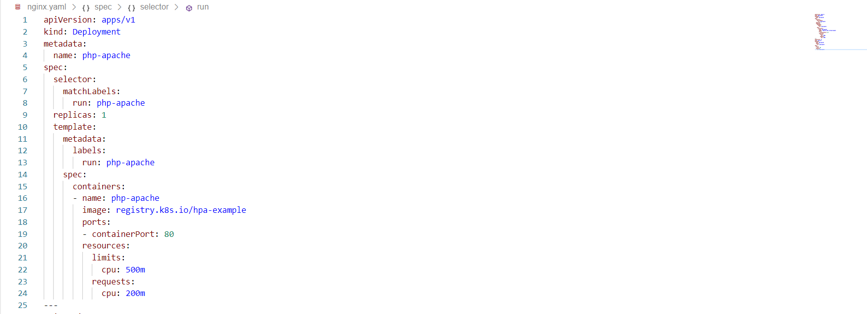
YAML Files

Slide 3
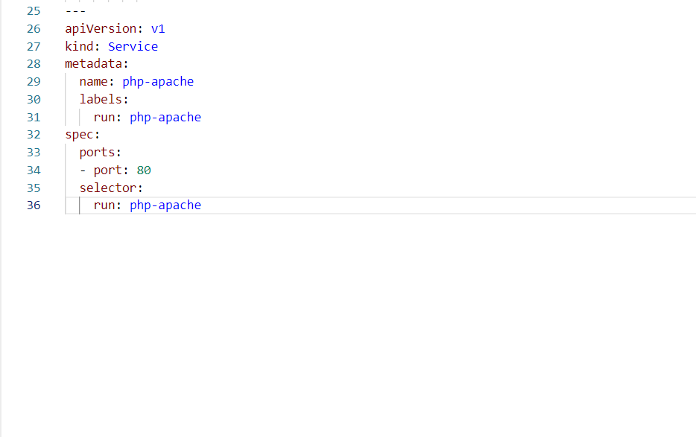

Slide 4
